Slide 1
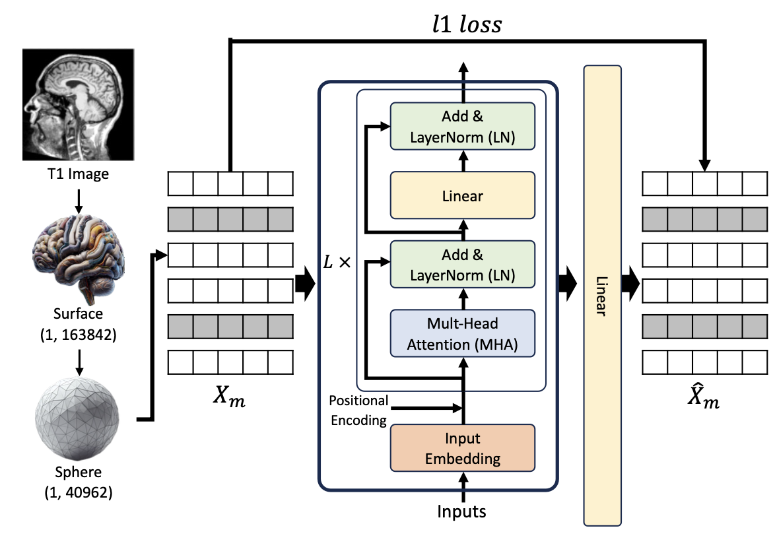
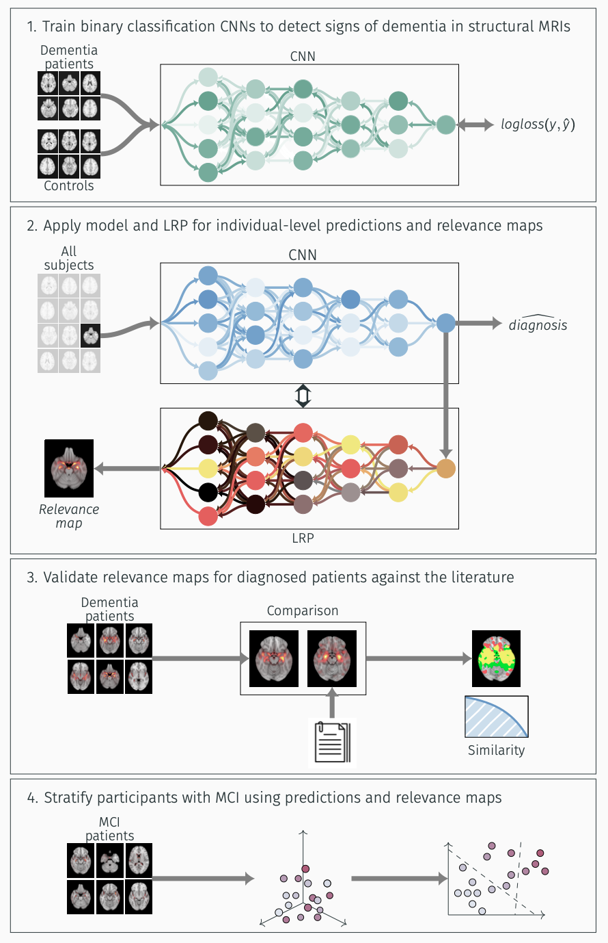


Predicting Brain Age from MRI Scans via Deep Learning
Francesco Sammarco
Ph.d. @ Laboratory for Mental Health Mapping
University of Jena//Tübingen
https://mhm-lab.github.io

Slide 2
Outline Presentation
Part 1: EDA
Part 2: Regression
Part 3: Deep Learning
Part 4: Explainability
Part 5: Personal Projects
https://mhm-lab.github.io

Slide 3
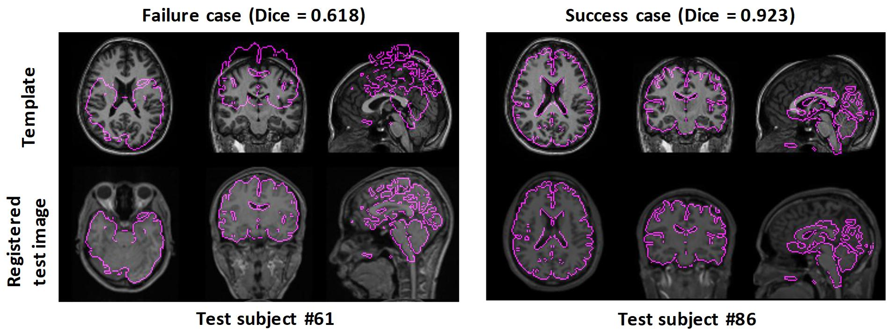
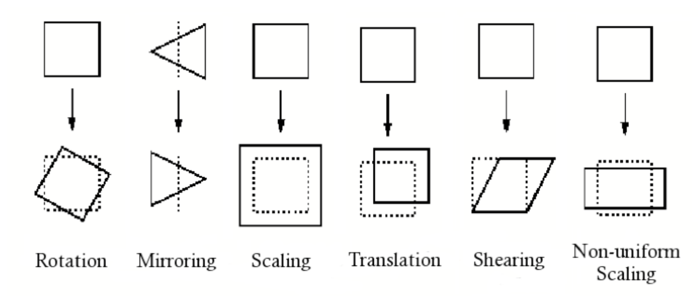
EDA: Registration of MRI images

Slide 4
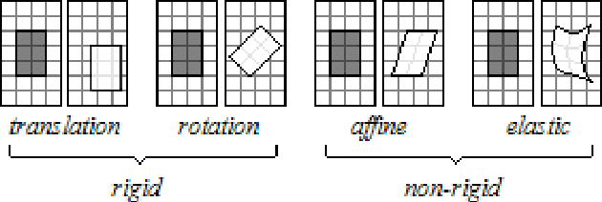
EDA: Registration of MRI images

Slide 5
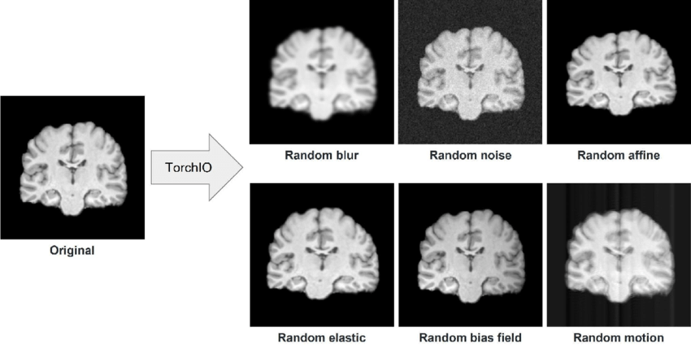
EDA: Registration of MRI images
Affine
Elastic

Slide 6
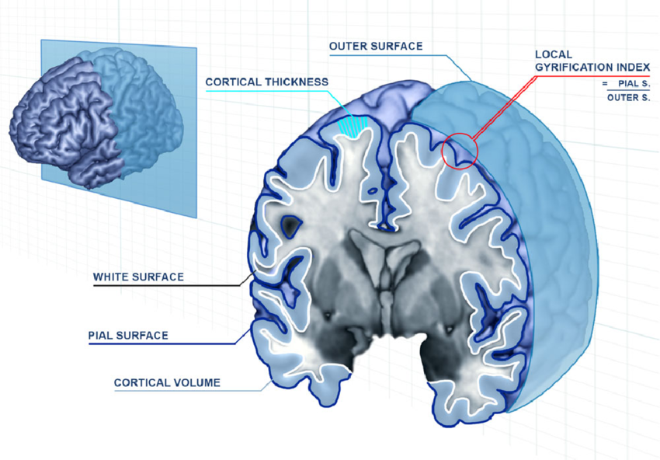
EDA: Corthical thickness

Slide 7
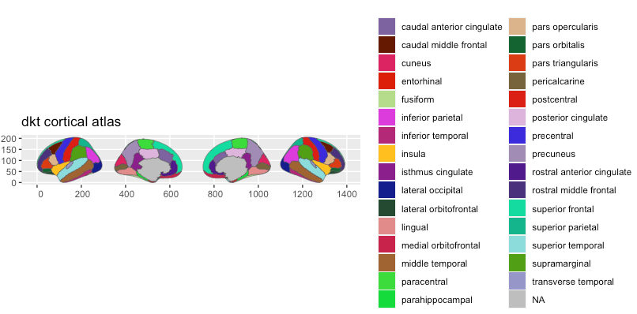
EDA: The DKT Atlas

Slide 8
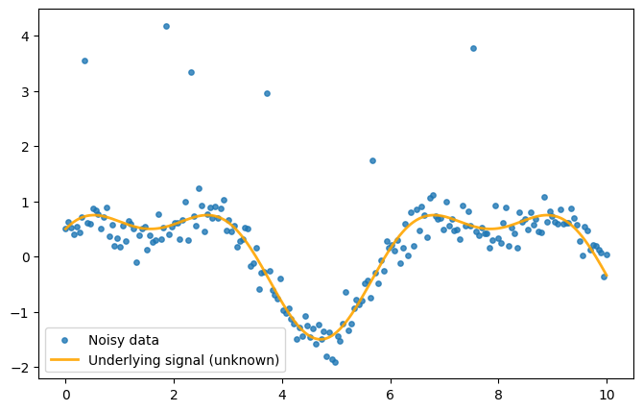
Regression: Locally estimated scatterplot smoothing
Let’s consider a set of randomly sampled points with the function:

Slide 9
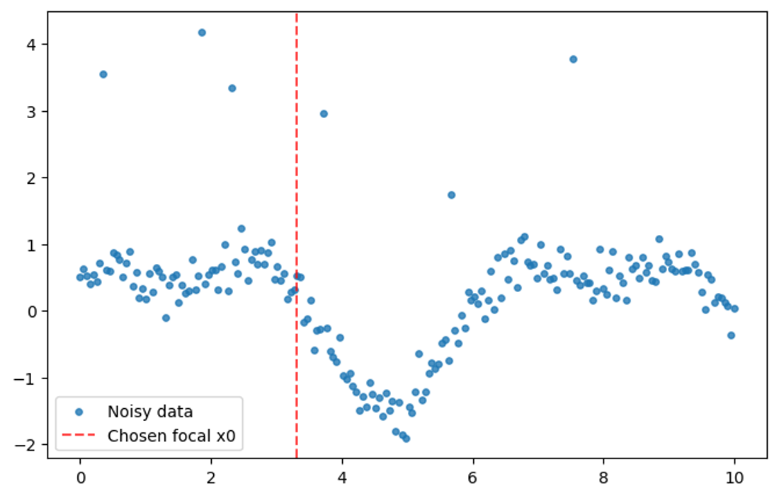
Regression: Locally estimated scatterplot smoothing
We consider a focal point $x_{0}$:

Slide 10
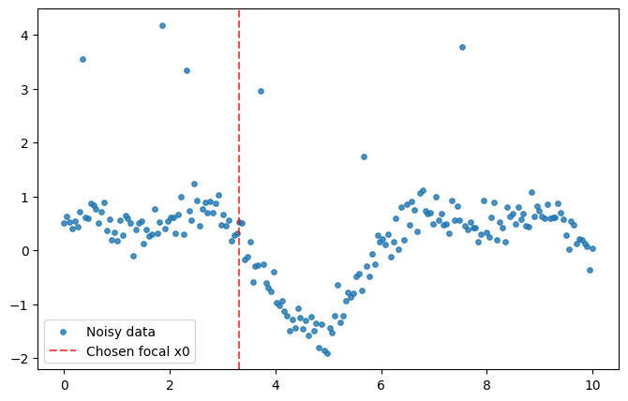
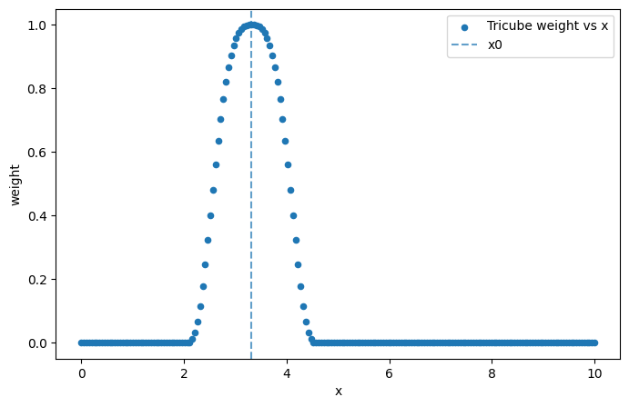
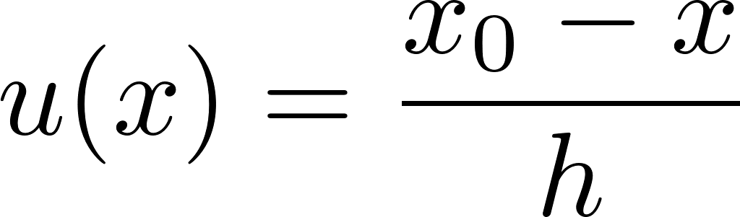
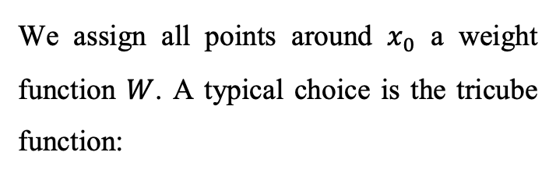
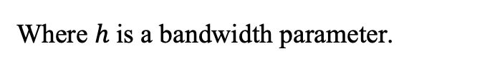
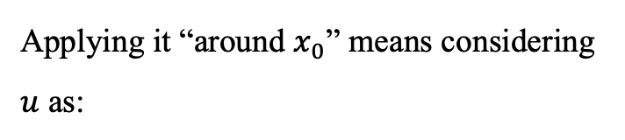
Regression: Locally estimated scatterplot smoothing
We assign all points around $x_{0}$ a weight function $W$. A typical choice is the tricube function:
Applying it “around $x_{0}$” means considering $u$ as:
Where $h$ is a bandwidth parameter.

Slide 11
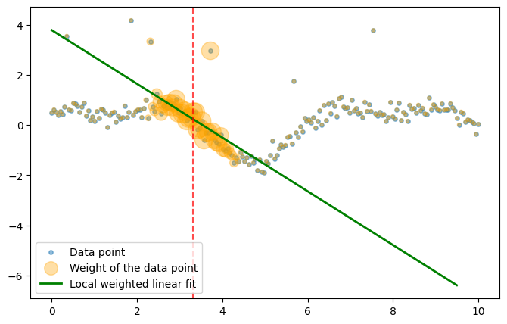
Regression: Locally estimated scatterplot smoothing
A local weighted regression model is fitted on the points, with weight from the function:

Slide 12
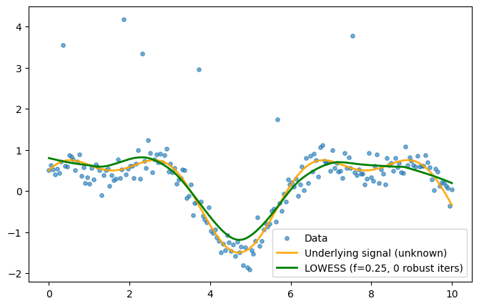
Regression: Locally estimated scatterplot smoothing
Fit this model for all values of $x$. The final model is composed by all the intercepts.

Slide 13
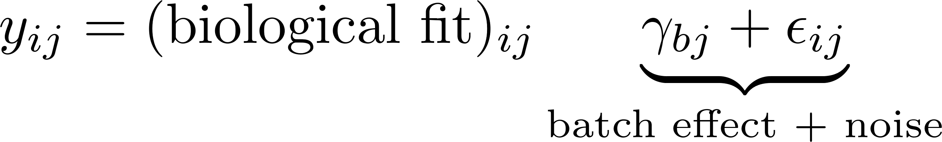
Regression: COMBAT
COMBAT supposes that the generic observation is structured by a biological fit and a “non-biological” fit:

Slide 14
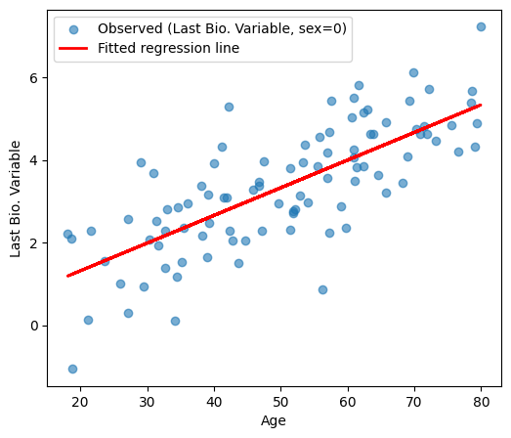
Regression: COMBAT
The idea is to separate the “biological” contribution from the “external contribution”. First we fit each biological variable via the biological variables.

Slide 15
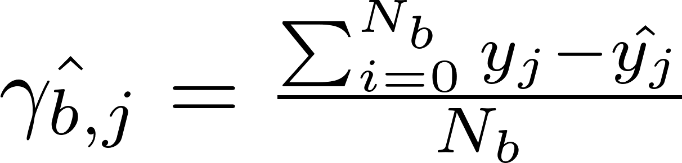
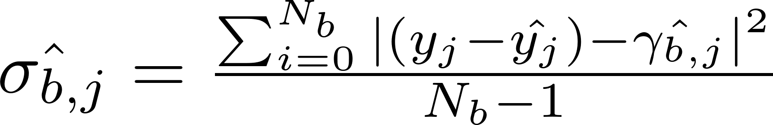
Regression: COMBAT
Now, we consider the difference not explained by the variables, i.e. the residuals. When separating each residual per “non-biological” variable, we can estimate mean and variance.

Slide 16
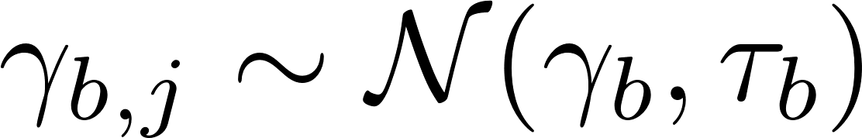
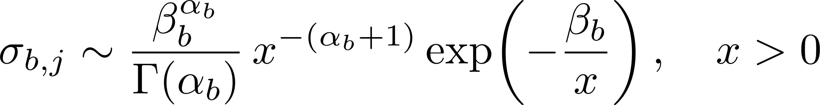
Regression: COMBAT
COMBAT assumes that each of the parameter obtained as before is drawn from a prior distribution. For the “mean” (called location effect):
The “standard deviation” (called scale effect) is supposed to be drawn by the so called Inverse Gamma function:

Slide 17
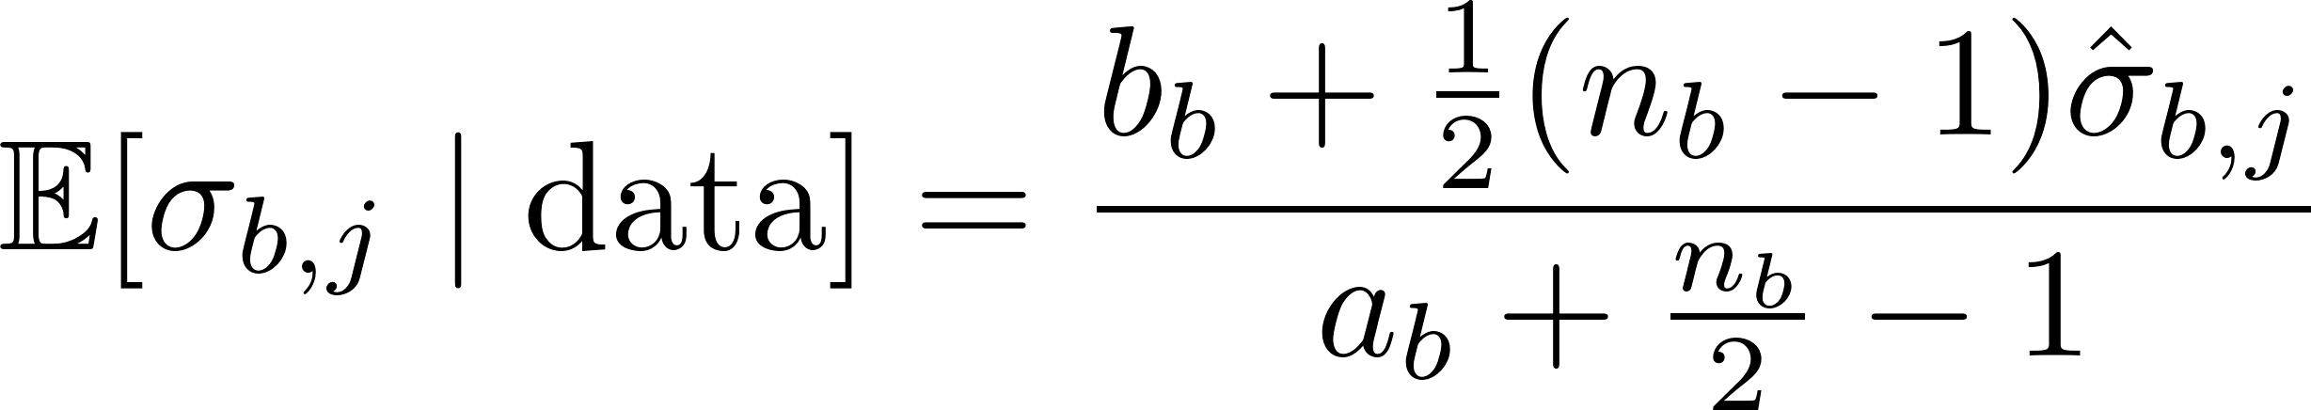
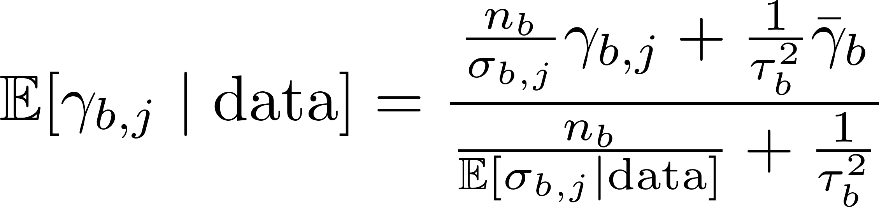
Regression: COMBAT
Doing so allows the method to turn the noisy per-feature estimates into posterior “shrunken” estimates. Basically, we estimate the posterior with the Bayes rule:
From the joint distribution, we “marginalize” the single parameter distribution. Since the priors are conjugate, we get again distribution of the same type of the priors.
From these marginals, we compute the expectation of our parameters given the data.

Slide 18
Regression: COMBAT
Doing so allows the method to turn the noisy per-feature estimates into posterior “shrunken” estimates. Basically, we estimate the posterior with the Bayes rule:
From the joint distribution, we “marginalize” the single parameter distribution. Since the priors are conjugate, we get again distribution of the same type of the priors.
From these marginals, we compute the expectation of our parameters given the data.
This are used to “shrink” the residuals and obtain the final scaled y values.

Slide 19
Regression: Kernel Ridge Regression
In Kernel regression, the idea is always to fit a set of points. Suppose again:

Slide 20
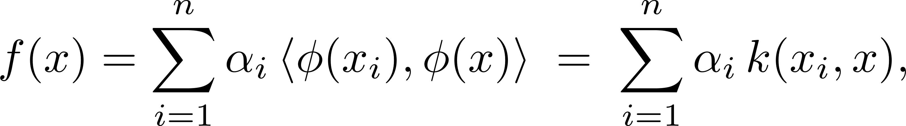
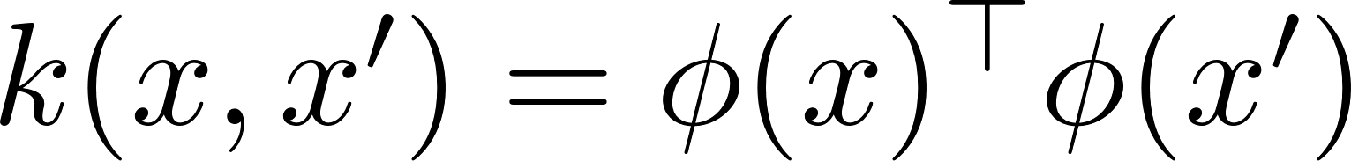
Regression: Kernel Ridge Regression
Kernel regression allows to model a set of complex features of the inputs by expressing them in terms of similarity of the inputs (the so called kernel trick):
We can replace the function k with any suitable distance function. One of the most used is the Radial Basis Function:

Slide 21
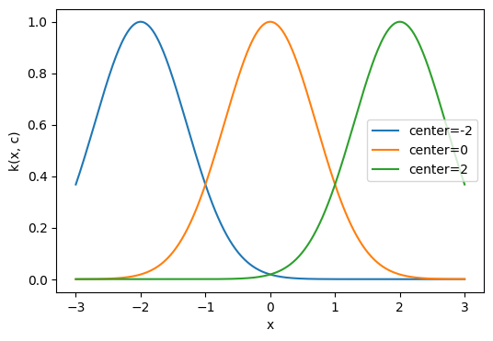
Regression: Kernel Ridge Regression
One can imagine the RBF kernel as taking a random point and introducing a gaussian centered (mean) in that point:

Slide 22
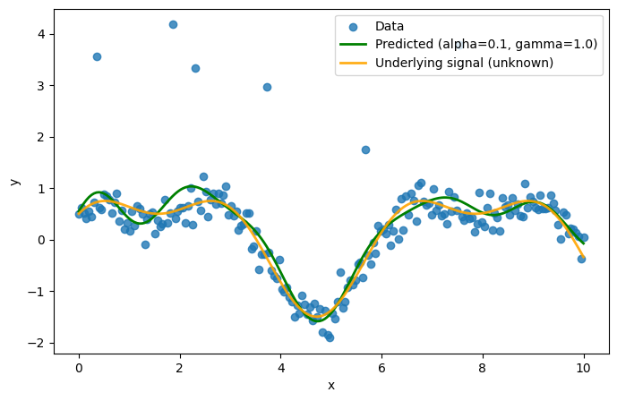
Regression: Kernel Ridge Regression
Kernel Ridge learns how to “weight” all these gaussian contribution for the training points and use this result to predict the next sample.

Slide 23
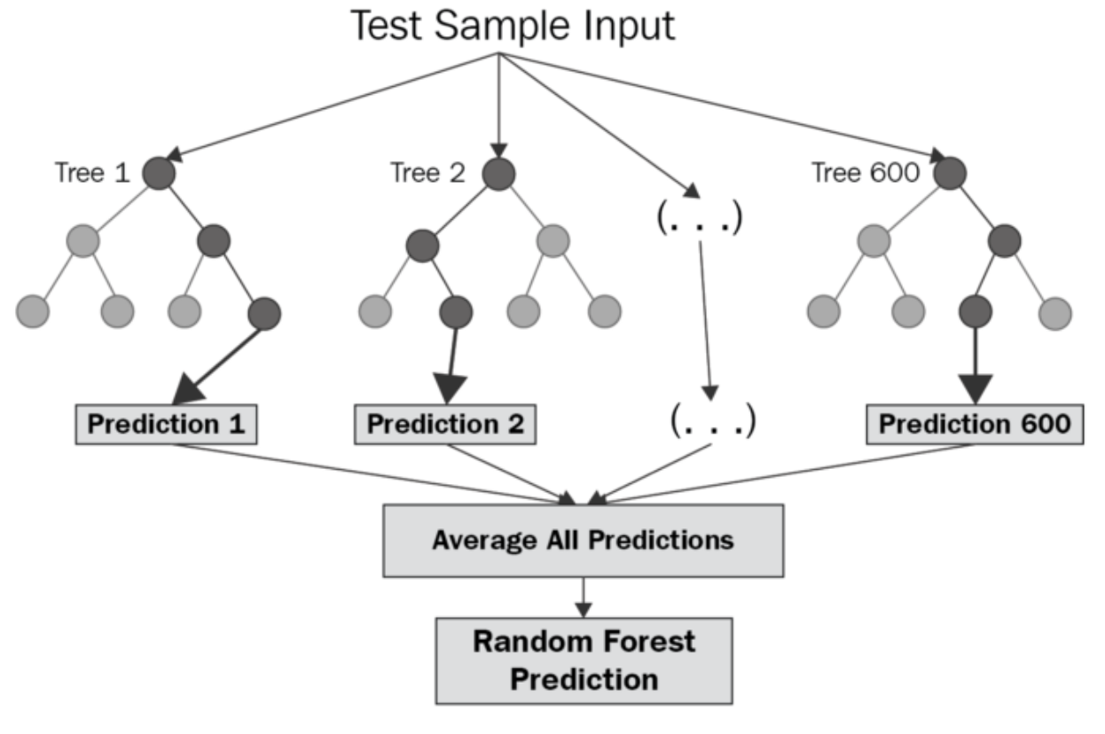
Regression: Random Forest

Slide 24
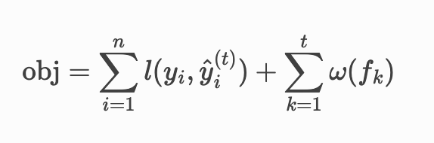
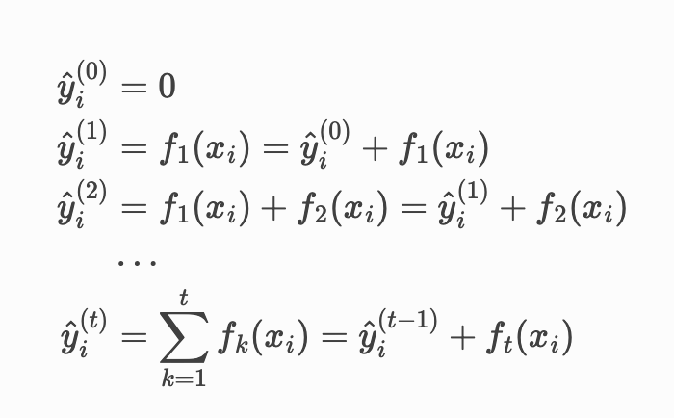
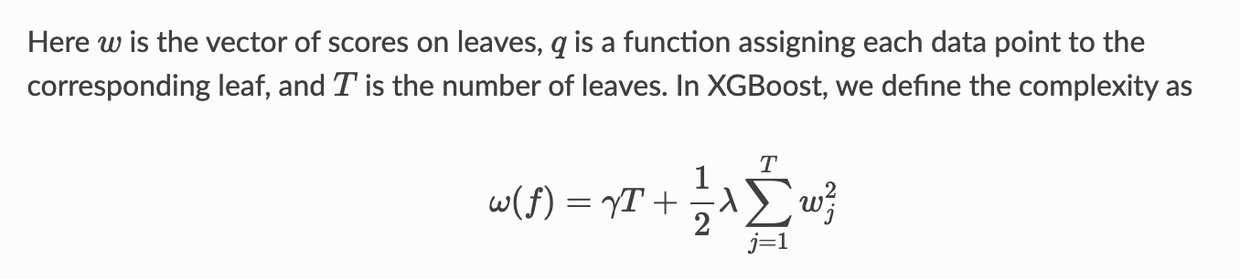
Explainability: XGBoost

Slide 25
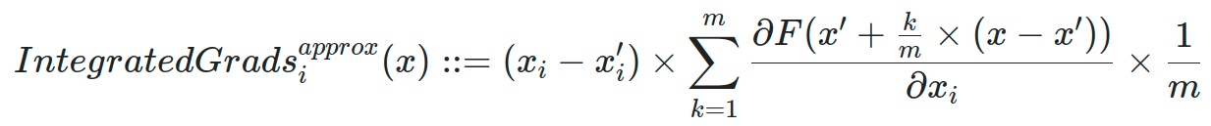
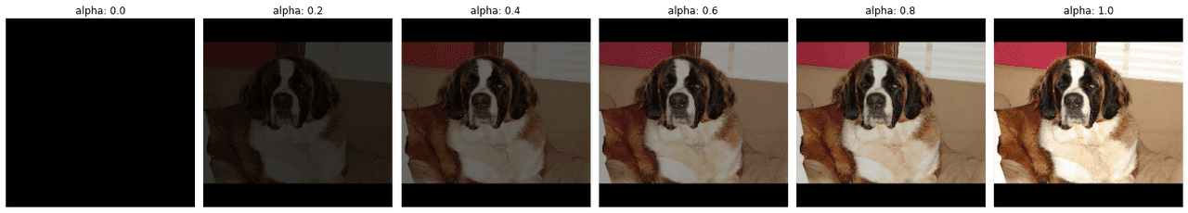
Explainability: Integrated Gradients

Slide 26
Thank you!

